Slide 1
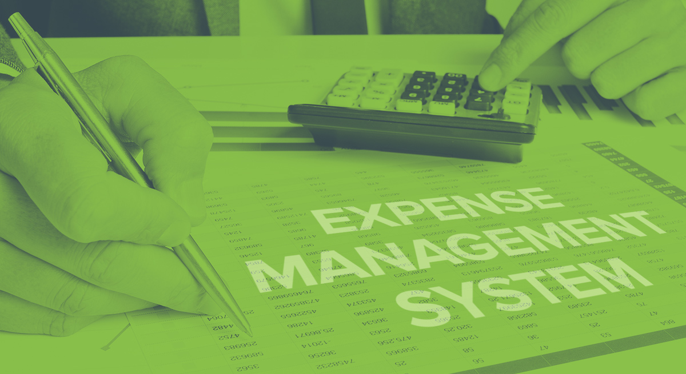
Expenses Management System
BY: suveksha khanal
Batch 21

Slide 2
Introduction
My project is called Expenses Management System. It can be used by a business or an individual to audit their expenses. This system allows user to input their income and expenses by logging onto their account.
It tracks their spending which allows them to have an idea of their expenses. Expenses management system analyses overall expenses, identifies cost-saving opportunities and controls excessive spending.

Slide 3
Problem statement
Expenses management system reduces having to memorise each and every expense that a user has done. It keeps track of all the expenses and income hence user do not have to memorize it.
Before this system, user may had to write their expenses down which involves the risk of loosing the evidence. Hence, this system allows user to keep track without loosing their data.
This system also allows user to control their expenses and motivates them to save.

Slide 4
Background of the project
Expenses Management system allows user to register and login, they can add their income as well as their daily expenses.
Their income and expenses will be saved into their account so they can come back and edit their details.
This system allows user to track their money and have control over their spending.

Slide 5
Aims and Objectives
Aims:
To build a system where user can add, update and track their expenses
To help user control their spending.
To generate expenses report at the end.
To calculate spending

Slide 6
Aims and Objectives
Objectives:
To perform better design
To perform better code
To manage time
To work according to the requirements
To perform different testing to make sure there are no flaws.
To perform step by step process to finish the project
To use Development methodology
To use Design pattern
To use structural architecture

Slide 7
Features of the project
The features of the project are as follows:
User can register on the page
User can register using their email and password
Login
Username will be set
User can login using their username and password
Edit profile
User can edit their profile such as username/ password
User can add/ edit expenses and income
Change password

Slide 8
Features of the project
Dashboard for user
Dashboard will help user to navigate through the page easily
Log out
Add income
User will need to add income to calculate their salary and expenses
Edit income
Add expenses
User need to add their expenses by remembering their spending
Their expenses will be saved.
Edit and view expenses

Slide 9
Features of the project
Add expense category such as “food” “fuel”
View details of expense category
Calculate their spending according to their income
Their spending will be calculated by subtracting it from their income
This will help user to track their income
Report of the expense
Report will be generated by calculating their expenses
Report of the expense category

Slide 10
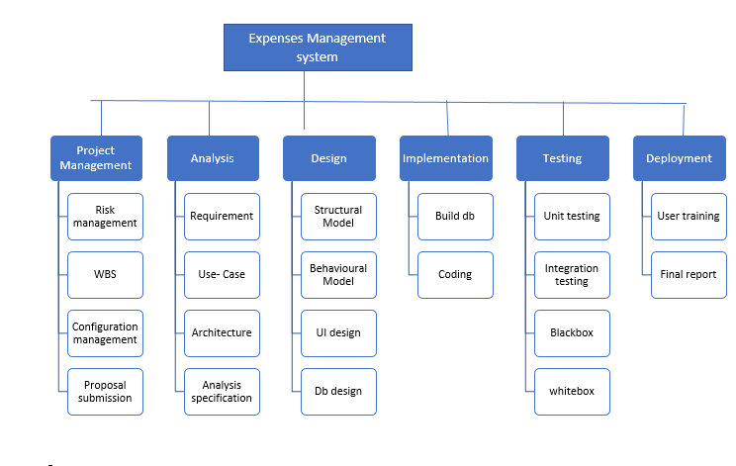
Work breakdown structure Work break down structure is a breakdown of a project into smaller parts to remove complexity. It organizes the team’s work into manageable section.

Slide 11
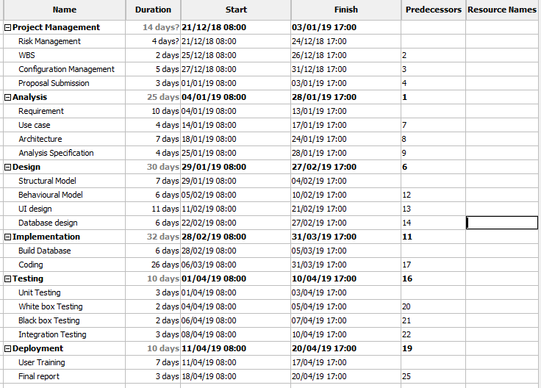
Gannt Chart

Slide 12
Methodology with justification
I have used waterfall model which is a development methodology where software is developed step-by-step. It is very easy to use and understand. In waterfall model each phase must be completed before moving to the next one, there is no overlapping of the phases. Waterfall model is also suitable for small projects. Waterfall model is divided into separate phases which are as follows:
Requirement
System Design
Implementation
Testing
Deployment
Maintenance

Slide 13
Why waterfall model?
I have used this methodology because:
It is easy to use
It is very easy to understand
It is used for small projects
Each phase is completed one at a time

Slide 14
Architecture
I am going to use tier-3. A three-tier architecture is a client-server architecture in which the functional process logic, data access, computer data storage and user interface are developed and maintained as independent modules on separate platforms
I have used MVC design patter for this project.
Model: It represents an object. It also has logic to update controller if the data changes.
View: It represents the visualization of the data that model contains.
Controller: It acts on both model and view. It controls data flow into model object.

Slide 15
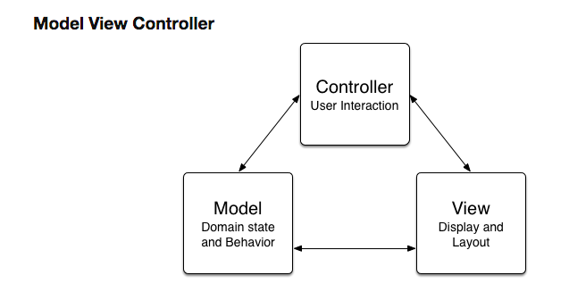
Architecture

Slide 16
Architecture
I have used MVC design pattern because:
Helps develop application faster
Modification does not affect the entire model because model part does not depend on the views part.

Slide 17
Risk and configuration management
Risk management is the process of identifying, accessing and controlling threats or risks of a system. It is easier to identify risk before they occur so it can be solved faster when they actually occur. Risk management helps minimize risks and time before they happen. Extra time is saved through risk management.

Slide 18
Risk and configuration management
Configuration management is a systems engineering process for establishing and maintaining consistency of a product's performance, functional, and physical attributes with its requirements, design, and operational information throughout its life eg: uploading in GitHub.

Slide 19
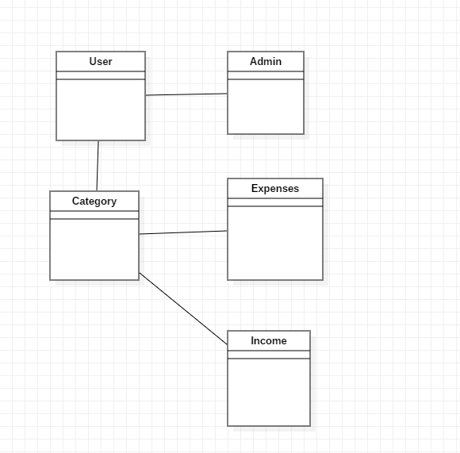
Initial class diagram

Slide 20
Justification
Class diagram is used to describe the structure of a system. Class diagram helps to understand the system and plan accordingly.
Advantage:
Provides detail insight into the structure of the system
They are simple and fast to read
Reduces maintenance time.
Disadvantage:
If it is complicated, it may be difficult to correlate with the code
They do not have any dynamics.

Slide 21
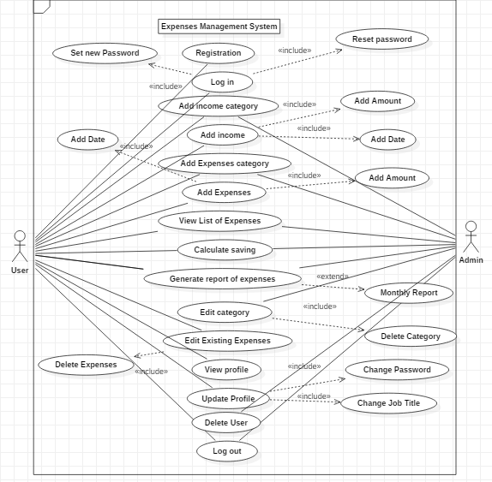
Use-Case diagram

Slide 22
Justification
I have used use case diagram so that it helps us design a system from user’s perspective. It is a useful technique for communicating system behaviour in the user's terms. It helps us to understand the requirement of the system and what the system is supposed to do.
Advantage
It helps to gather functional requirements of a system
It is easily understandable
It gathers additional behaviour that can improve system robustness.
Disadvantage
Use case only summarises some of the relationships between use cases, actors and systems
Use case does not show the order in which steps are performed
Does not gather the non-functional requirements.

Slide 23
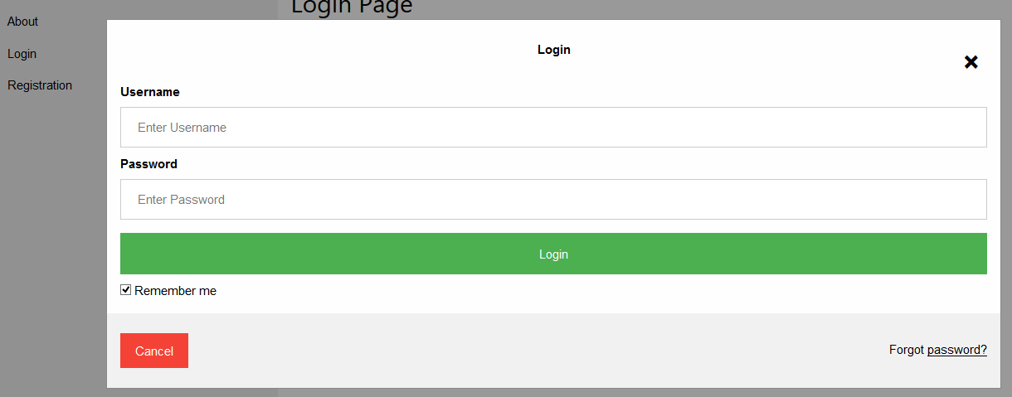
UI design
My UI design are as follows:

Slide 24
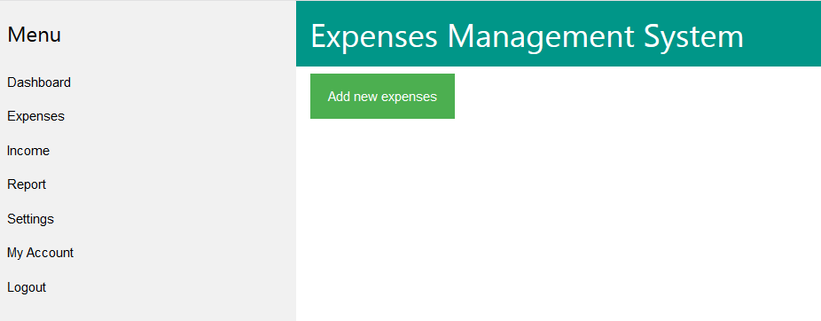

Slide 25
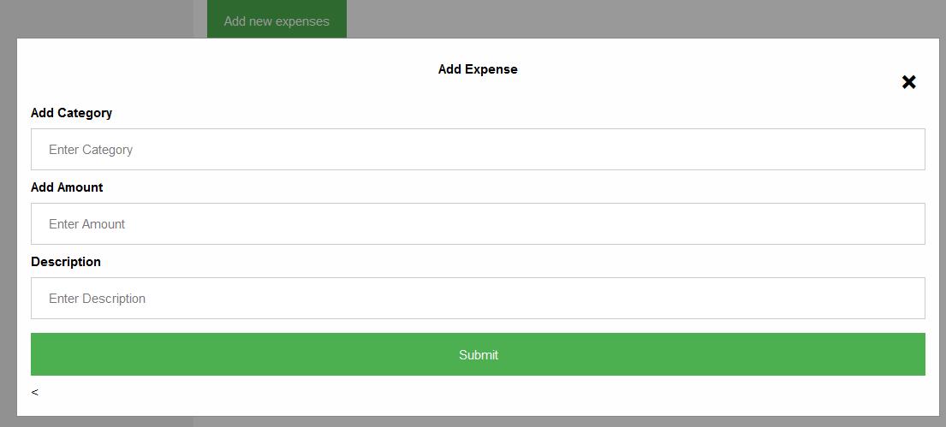

Slide 26
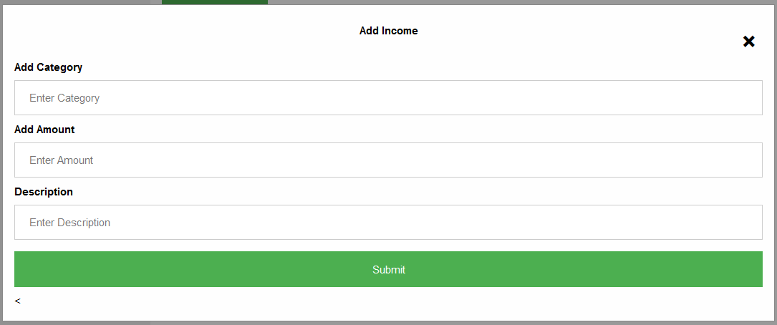

Slide 27
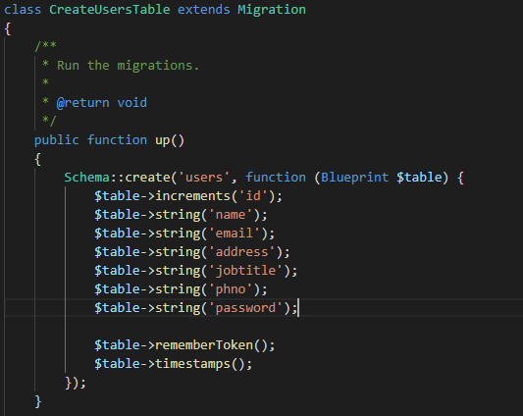
Coding

Slide 28
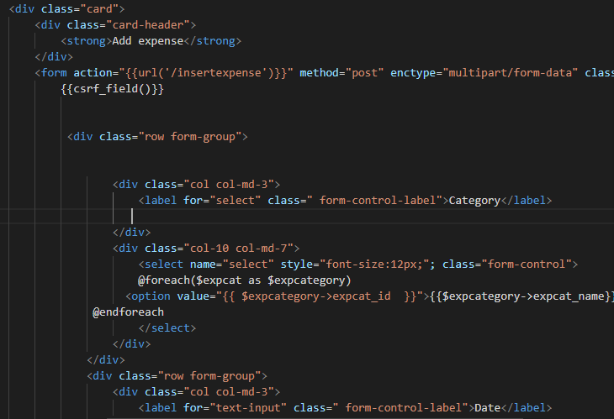
Coding

Slide 29
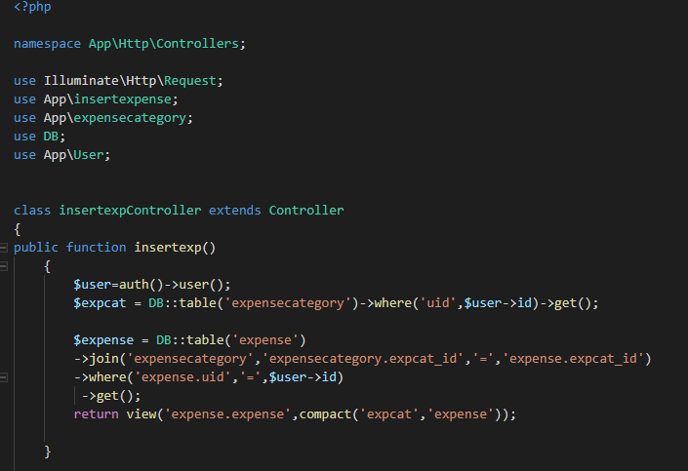
Coding

Slide 30
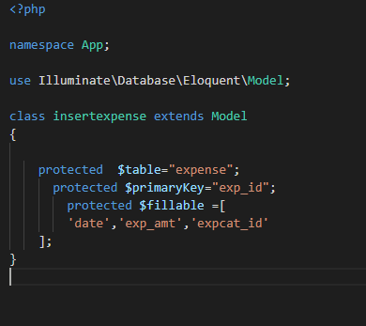
Coding

Slide 31
Test Cases

Slide 32
Future works
To improve this project for the future, I would like to add features such as:
Mobile Accessibility
Receipt Imaging- uploading image of the receipt directly into the system
Credit Card Integration- integrate credit card account right into the system.

Slide 33
User Manual

Slide 34
Conclusion
Thank you for listening to my presentation!!

Slide 35
Reference

